Slide 1
Standardizing Zones Across the Storage Ecosystem
Sponsored by NVM Express™ organization, the owner of NVMe™, NVMe-oF™ and NVMe-MI™ standards

Slide 2

Speaker
Dave Landsman
Director of Industry Standards

Slide 3
Beyond Random IO – New Use Cases for NVMe
Over past couple years, industry debate on Open Channel vs. “Traditional” SSDs
Debate is really about the emergence of two new SSD use case categories
IO Isolation
Focus on Latency/QoS
Host control over SSD physical topology
Write Amp Reduction
Focus on Capacity/Cost
Host/SSD collaboration on GC and Wear Leveling
New: Zoned Namespaces
Application 1
Application 2
Application 3
Application 1
Application 2
Application 3
NVMe 1.4: IO Determinism
NVM Sets & Endurance Groups
Predictable Latency Mode
LBA space divided into fixed size ranges
ZNS SSD Controller
ZNS SSD Controller
Deterministic
Non-Deterministic
Zone 0
Zone 1
Zone 2
Zone 3
Zone n
Non-Deterministic
Deterministic
All Writes Sequential
New: Endurance Group Mgmt
Enable standard provisioning of topology isolation use cases
Write commands
advance write pointer
Write pointer
Reset write pointer commands
rewind the write pointer

Slide 4
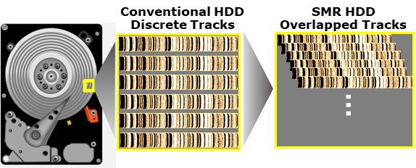
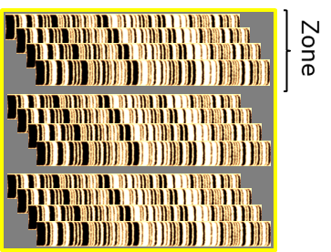
Zoned Block Storage already in HDDs
Take advantage of SMR capacity growth
SMR (Shingled Magnetic Recording)
Enables areal density growth
Causes magnetic media to act like flash
Data must be erased to be re-written
Zoned Block access for HDDs
Drive formatted into fixed sized regions
Host/Device enforce sequential writes in LBA space to mitigate RMW effects of SMR
Zoned Block interface standardized in T13/T10
Zoned ATA Commands (ZAC): SATA
Zoned Block Commands (ZBC): SAS

Slide 5
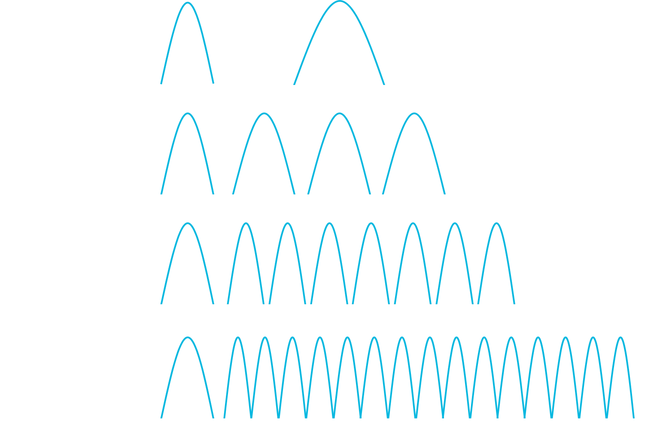
Why Zoned Block Storage for SSDs
Take advantage of TLC/QLC capacity growth
TLC & QLC increases capacity but at cost of
Less endurance
Lower performance
More DRAM to map higher capacity
Zoned Block access for SSDs
SSDs are intrinsic Zoned devices due to flash characteristics
Host/SSD cooperate (distributed FTL) using sequential access
No complex topology provisioning; Zones are logical
Reduces write amplification and internal data movement
Result
Reduced wear
Improved latency outliers and throughput
Reduced DRAM in SSD (smaller L2P)
Reduced drive Over Provisioning
Application 1
Application 2
Application 3
Application 1
Application 2
Application 3
Conventional SSD Controller
ZNS SSD Controller
LBA Space
Zoned LBA Space
Zone

Slide 6

Why Zoned Block Storage for SSDs?
Synergy w/ ZAC/ZBC software ecosystem
LBA or file based GC
Level of Optimization
Data structure driven GC
User Space
SW ecosystem optimized at multiple levels
Foundation is the Zoned Block Device
Different optimization paths
App -> POSIX File -> Unmodified FS -> dm-zoned -> ZBD
App -> POSIX File -> Modified FS -> ZBD
FS knows which LBAs in which file
Modified App -> ZBD
No file system; app knows most about data; e.g., may use zones as containers for objects
We are adding changes for ZNS
Unmodified Applications
Modified Applications
CEPH
BluesStore
+ ZNS
+ ZNS
LevelDB
RocksDB
POSIX File I/F
Linux Kernel
Unmodified FS (xfs)
FS with ZBD Support
(f2fs, btrfs, xfs)
+ ZNS
Block Device I/F
Logical Blk Device
(dm-zoned)
+ ZNS
Zoned Block Device I/F
Block Layer (ZAC/ZBC)
+ ZNS
SCSI/ATA SMR HDD
+ ZNS SSD

Slide 7
Zoned Namespaces TP
Ongoing in the NVMeTM working group
Inherits NVM Command Set
Namespace divided into fixed sized Zones
Sequential Write Required is only zone type supported for now
Aligned to host-managed ZAC/ZBC model, with some SSD optimizations
Zone Capacity
Zone Append
LBA space divided into sequentially written ranges
Zone 0
Zone 1
Zone 2
Zone 3
Zone X
Sequential Write Required
Write commands
advance write pointer
Write pointer
Reset write pointer commands
rewind the write pointer

Slide 8
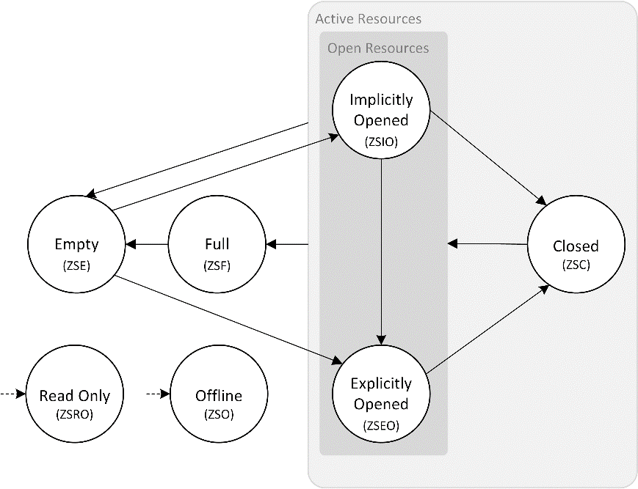
Zoned Namespaces TP
Zone Capacity
ZNS State Machine
ZNS model similar to ZAC/ZBC
States: Empty, Full, Implicit Open, Explicit Open, Closed, Read Only, Offline
State Changes: Write, Zone Management Command (Open, Close, Finish, Reset), Device Resets
Zone Size vs. Zone Capacity^{(NEW)}
Zone Size is fixed
Zone Capacity is variable
Zone Size (e.g., 512MB)
Zone X - 1
Zone X
Zone X + 1
Zone Start LBA
Zone Capacity (E.g., 500MB)

Slide 9
Zoned Namespaces TP
Zone Append
ZAC/ZBC requires strict write ordering
Limits write performance, increases host overhead
Low scalability with multiple writers to a zone
One writer per zone -> Good performance
Multiple writers per zone -> Lock contention
Performance improves somewhat by writing to multiple Zones
With Zone Append, we scale
Append data to a zone with implicit write pointer
Drive returns LBA where data was written in zone
Metal (i7-6700K, 4K, QD1, RW, libaio)
1500
1300
1100
900
700
K IOPS
500
300
100
-100
1
2
3
4
Number of Writers
1 Zone
4 Zones
Zone Append

Slide 10
Zoned Namespaces TP
How does Zone Append work?
Zone Write Example
Queue Depth = 1
Zone Append Example
Queue Depth = 3
4K Write₀
16K Write₂
4K Write₀
16K Write₂
8K Write₁
8K Write₁
Zone
Zone
WP
(after W₀)
WP
(after W₁)
WP
(after W₂)
WP
(after all writes)
Host serializes I/O, forces low queue depth
Insignificant lock contention when using HDDs
Significant lock contention when using SSDs
No host serialization; higher queue depth
Scalable for HDDs and SSDs

Slide 11
Summary – Zoned Namespaces
Standardizes interface for key evolving SSD use case
Sequential-write centric workloads
Host/SSD cooperate on GC and WL
Enables lower cost solutions
Reduced wear
Reduces SSD DRAM
Reduced overprovisioning
SW model synergy w/ SMR HDD ecosystem
Specification nearing completion in NVMeTM WG

Slide 12
Questions?

Slide 13
BACKUP

Slide 14
RocksDB and Zoned Block Devices
Embeddable key-value persistent store where keys and values are arbitrary byte streams.
Optimized for fast storage, many CPU cores and low latency
Based on Log-Structured Merge (LSM) Tree data structure
The LSM structure aligns with Zones, and enables significant optimizations
Integrates with MySQL databases (MyRocks)
Patches are in progress
RocksDB
In memory
Append-only
e.g. 64MB
memtable
sync
Hot Data
e.g. 128MB
L0
Persisted
A
Z
A
Z
A
Z
A
Z
sstable
Most Updated
compaction
e.g. 1G
L1
A
Z
Grows 10X
…
compaction
Cold Data
e.g. 100G
Ln
…
A
Z
Least Updated

Slide 15
Ceph and Zoned Block Devices
Zettabyte Infrastructure
CEPH
Distributed File-System providing object, block and file-level storage.
Enable Ceph to utilize Zoned Block Devices
Ceph Bluestore removes the local file system from the equation
BlueFS backend writes data directly to the block device and can handle the sequential constraints
RocksDB uses LSM-trees that naturally generate no/few random updates and can easily be stored on ZBDs as well
Zones or group of zones can map to natural failure domains that may be smaller than the whole device
Mapping OSDs to such failure domains would naturally ensure that recovery from failure would involve less network utilization and fewer I/Os
FileStore
BlueStore
data
omap
data
metadata
leveldb
RocksDB
BlueFS
Legacy XFS
XFS with
ZBD support
Linux
Kernel
Logical Block Device
(dm-zoned)
Block Layer
SCSI/ATA
NVMe
SMR HDD
ZBC/ZAC
ZNS SSD

Slide 16
Zoned Namespaces TP
Attributes: Zone Excursions & Variable Capacity
For NVMeTM devices that implement the Zoned Command Set, there is optional support for:
Variable Capacity
The completion of Reset Zone command may result in a notification that zone capacity has changed
Zone Excursions
The device can transition a zone to Full before writes reaches the Zone Capacity. Host will receive an AEN and write failure if writing after the transition
If device implements, the host shall implement as well
Incoherent state model if not – Software should be specifically be written to know that zone capacity can change, or writes may suddenly fail
Zone Excursion
Zone Size (e.g., 512MB)
Zone X - 1
Zone X
Zone X + 1
Zone Start LBA
Zone Capacity (E.g., 500MB)

